Slide 1
Big Mountain Resort
Executive Presentation
Jeannie Halvorson
April 15, 2024

Slide 2
Overview
Big Mountain Resort, located in Montana, is seeking to optimize its ticket pricing and investment strategies. With a new data-driven approach, our goal is to provide guidance on selecting better ticket prices and evaluating potential cost-cutting measures or investments to support higher ticket prices.

Slide 3
Understanding the problems
Review Pricing Strategy:
Understand Costs:
Evaluate Investments:
Current ticket prices may not accurately reflect the value offered compared to competitors, potentially leading to missed revenue opportunities or customer dissatisfaction.
Limited insight into operational costs across maintenance, staffing, marketing, and investments hampers decision-making and resource optimization.
Lack of cost-benefit analysis for investments may result in inefficient allocation of resources and potential divergence from long-term strategic goals.

Slide 4
Recommendations to the problems
Review Pricing Strategy:
Understand Costs:
Evaluate Investments:
Our analysis suggests that Big Mountain Resort could potentially increase its ticket prices to approximately $94, better aligning with market expectations and maximizing revenue.
It is crucial for the resort to gain a deeper understanding of its cost structure across various operational areas, including maintenance, staffing, marketing, and investments. By gathering comprehensive cost data, the resort can make more informed decisions and optimize resource allocation.
Before making significant investments in facilities or operations, Big Mountain Resort should conduct thorough cost-benefit analyses. This will enable the resort to identify the most promising investment opportunities that align with its long-term strategic goals.

Slide 5
Key Findings
The modeled ticket price for Big Mountain Resort is significantly higher than its current price, indicating potential room for a price increase.
Adding 0.2 miles to the LongestRun and 4 acres to Snow Making capacity could potentially increase the ticket price, but careful evaluation of cost-effectiveness and feasibility is necessary.
Thorough analyses of run closures' usage, maintenance costs, and overall impact on the visitor experience are essential for making informed decisions.
One deficiency in the data is the lack of detailed cost information, which hampers accurate financial modeling and decision-making.

Slide 6
Modeling results and analysis
Currently, Big Mountain Resort charges $81 for a day ticket. According to our modeling, the ticket price that could be supported in the marketplace by Big Mountain's facilities is approximately $94. This suggests that there is room for a price increase to better reflect the value provided by the resort.
It's important to highlight the competitive landscape, the unique features and offerings of Big Mountain Resort, and the potential benefits of aligning prices with market expectations.
Additionally, it's crucial to consider the additional operating cost of the new chair lift per ticket, which, based on each visitor on average buying 5 day tickets, would need to be factored into the pricing strategy to ensure profitability.

Slide 7
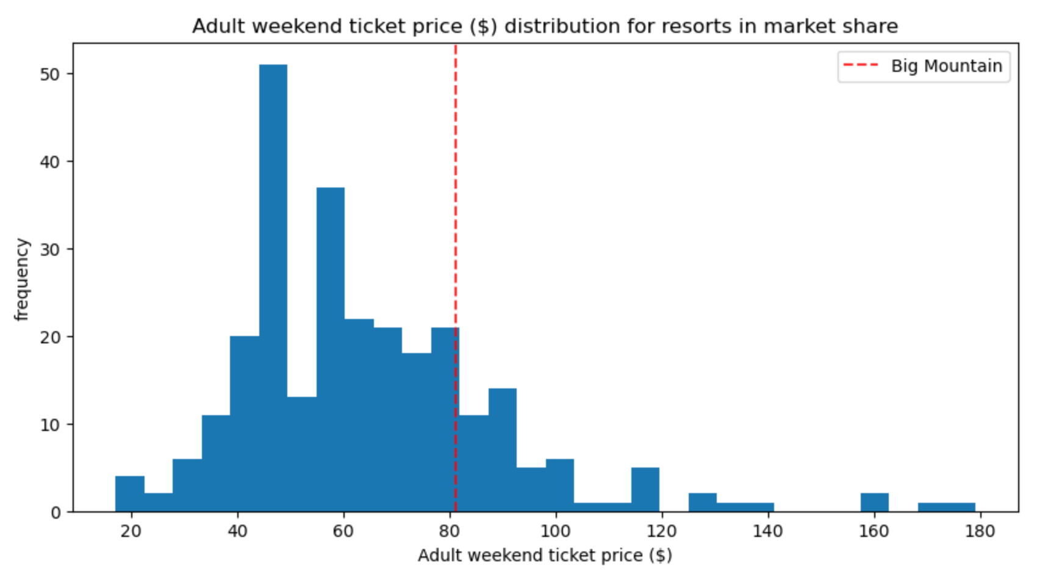
Modeling results and analysis

Slide 8
Modeling results and analysis
For future improvements, several scenarios were modeled to assess the impact of various changes on ticket prices and revenue. Among these scenarios, the addition of 0.2 miles to the LongestRun and 4 acres to Snow Making capacity could potentially increase the ticket price. However, it's essential to carefully evaluate the cost-effectiveness and feasibility of implementing these changes.
To progress with any run closures, the business could conduct thorough analyses to assess the usage, maintenance costs, and overall impact of each run on the visitor experience. Implementing test closures during non-peak times and collecting feedback from visitors could provide valuable insights for decision-making.
Additionally, considering alternative revenue-generating strategies such as offering premium services or amenities could help offset any potential negative impacts of run closures on visitor satisfaction and revenue.

Slide 9
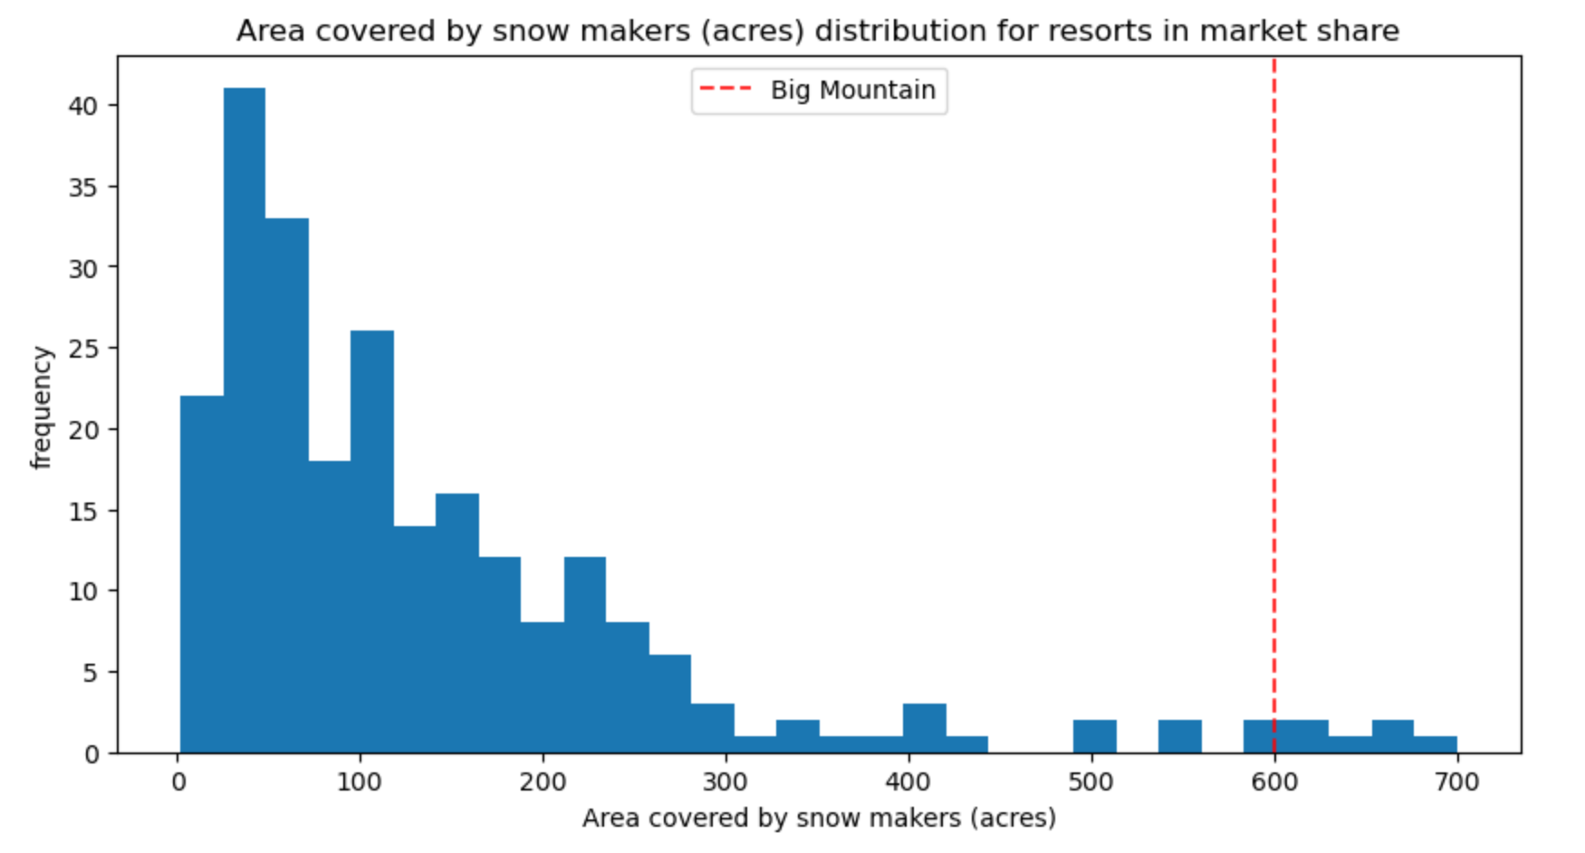
Modeling results and analysis

Slide 10
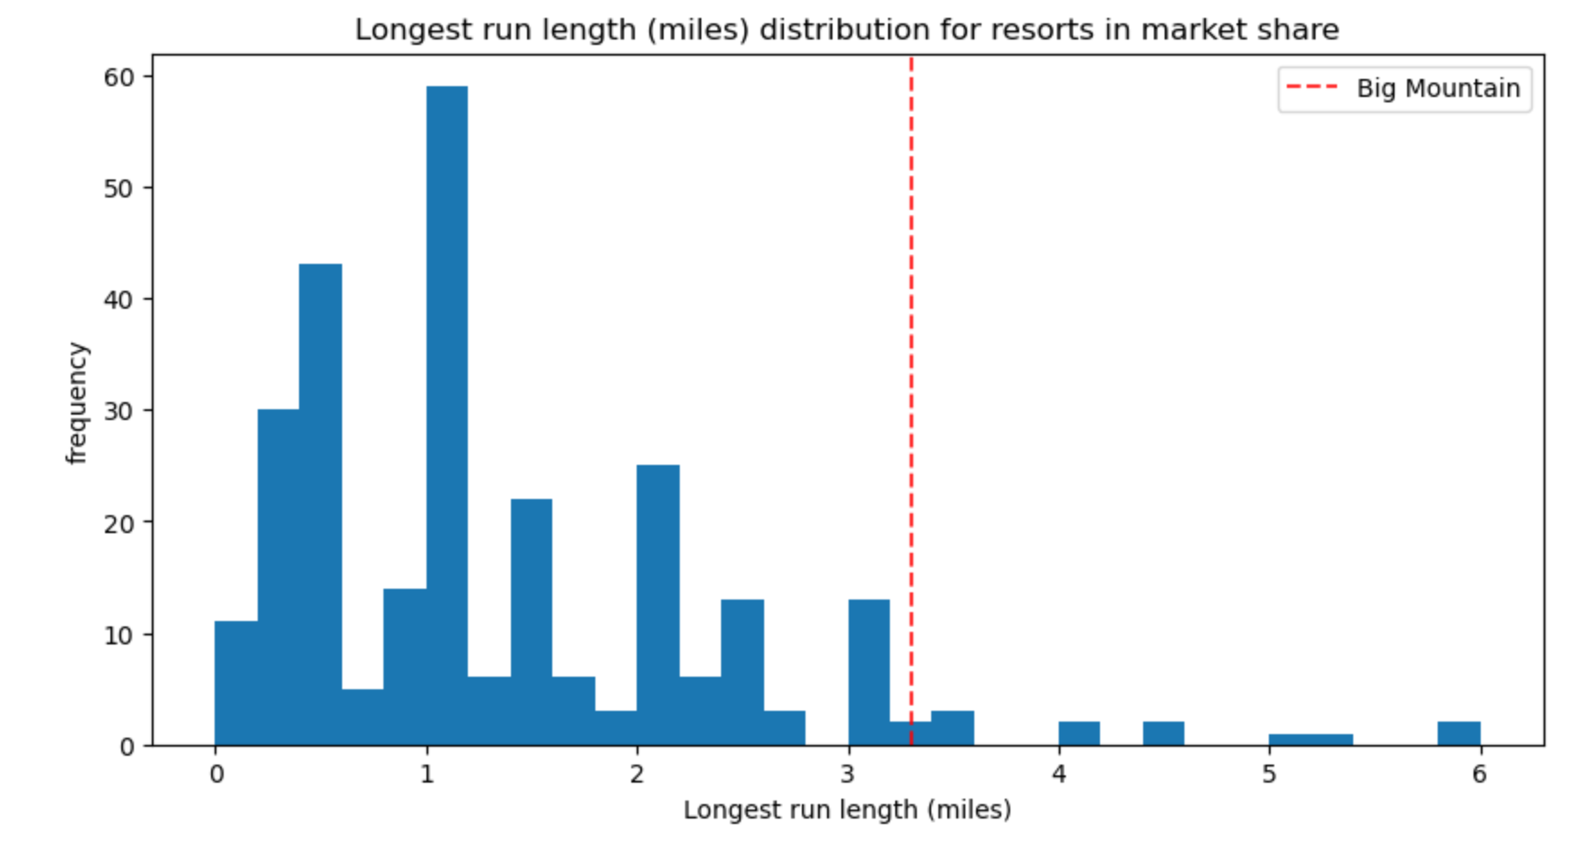
Modeling results and analysis

Slide 11
Conclusion
Big Mountain Resort has the opportunity to optimize its pricing strategy, understand its costs more comprehensively, and evaluate investments strategically to enhance its competitive position and maximize profitability.
By aligning ticket prices with market expectations, gaining deeper insights into cost structures, and making informed investment decisions, the resort can unlock new opportunities for growth and sustainable success in the ski industry.
The implementation of data-driven approaches and the utilization of predictive models will enable Big Mountain Resort to navigate challenges, capitalize on strengths, and drive value for its customers and stakeholders.

